Slide 1
SMART NOTICE BOARD
domain:
Internet of things(iot)
Software:
Arduino ide(open source) team members:
guide by nandhini j
Sugunathalakshmi.r Sruthi s
Gomathi a

Slide 2
Agenda
Abstract
Introduction
Components used
Node Mcu
Circuit Diagram
Connections
Advantages and Disadvantages
Output
Display

Slide 3
Abstract
Building a IoT based projects gives the fast transformation of data and the user can access the data from anywhere in the world.
we have developed a IoT based smart notice board. The main objective of this project is develop a automatic , updated electronic notice board.
The user can write the data from anywhere in the world to the LCD. This will reduce the time to update the data as well as it will efficiently transfers the data’s to the end user.

Slide 4
Introduction
This smart notice board is available in many educational institutions, banks and public places
This is done by using a microcontroller and GSM.
Through sending a message , the user can get the data in LCD display. So, the existing system uses GSM based notice boards.

Slide 5
Components
SNO | COMPONENTS | DESCRIPTION | QUANTITY
1 | Node MCU | ESP8266-12E Board | 1
2 | LCD Display | JHD162A 16X2 LCD Display | 1
3 | Connecting Wires | Jumper Wires
4 | Potentiometer | 10K | 1
5 | Breadboard and resistor | - | 1

Slide 6
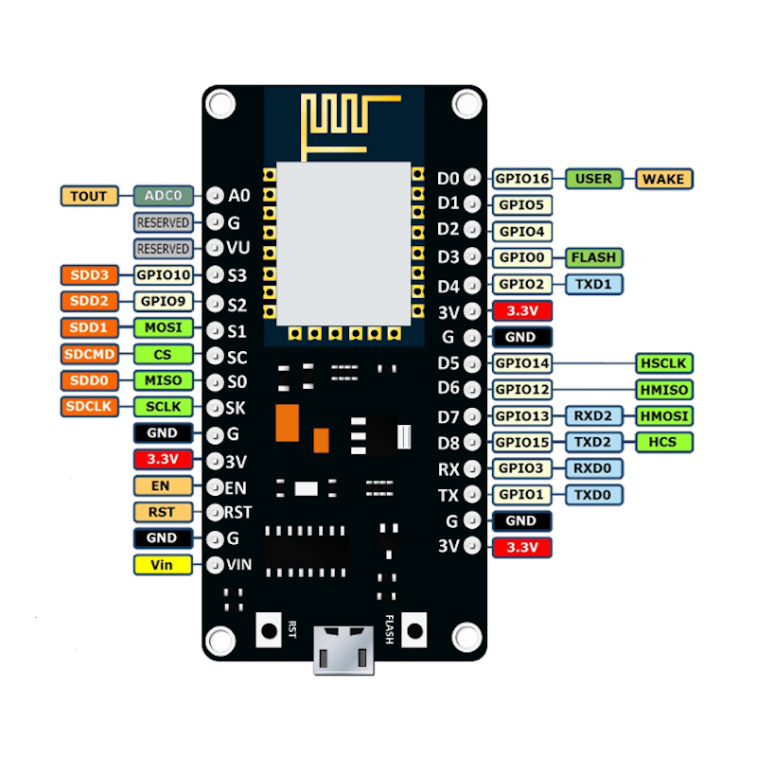
Node mcu
The NodeMCU is a popular development board based on the ESP8266.
It easy for you to test and develop projects for the ESP8266.
NodeMCU is a microcontroller development board with Wi-Fi capability. It uses an ESP8266 microcontroller chip.

Slide 7
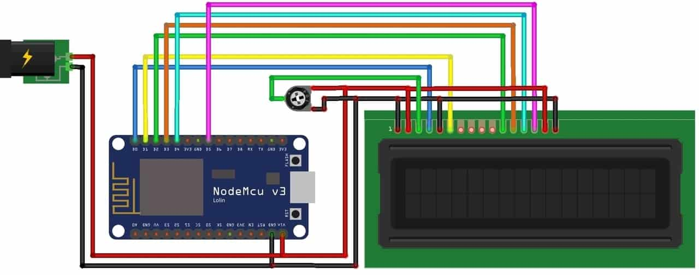
circuit diagram

Slide 8
Connections:
We need following connections between NodeMCU & LCD Display. RS pin of LCD — D0 pin of NodeMCU EN pin of LCD — D1 pin of NodeMCU D4 pin of LCD — D2 pin of NodeMCU D5 pin of LCD — D3 pin of NodeMCU D6 pin of LCD — D4 pin of NodeMCU D7 pin of LCD — D5 pin of NodeMCU

Slide 9
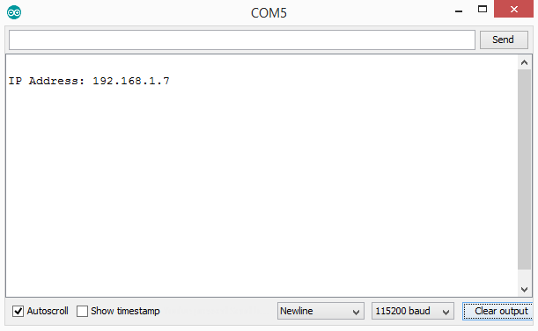
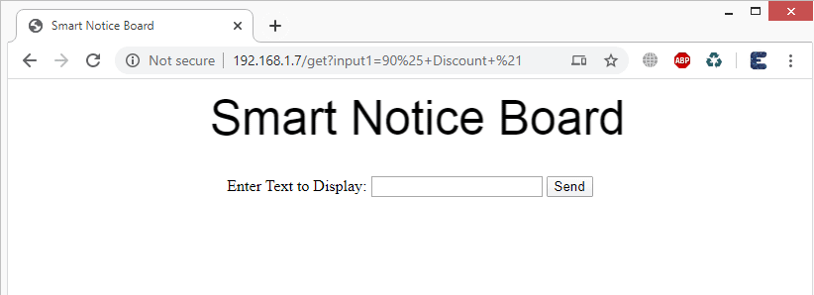
output

Slide 10
advantages
Interactive with others.
Low power consuming.
Easy to maintain.
Time management.
Lowering manual work.

Slide 11
disadvantages

Slide 12
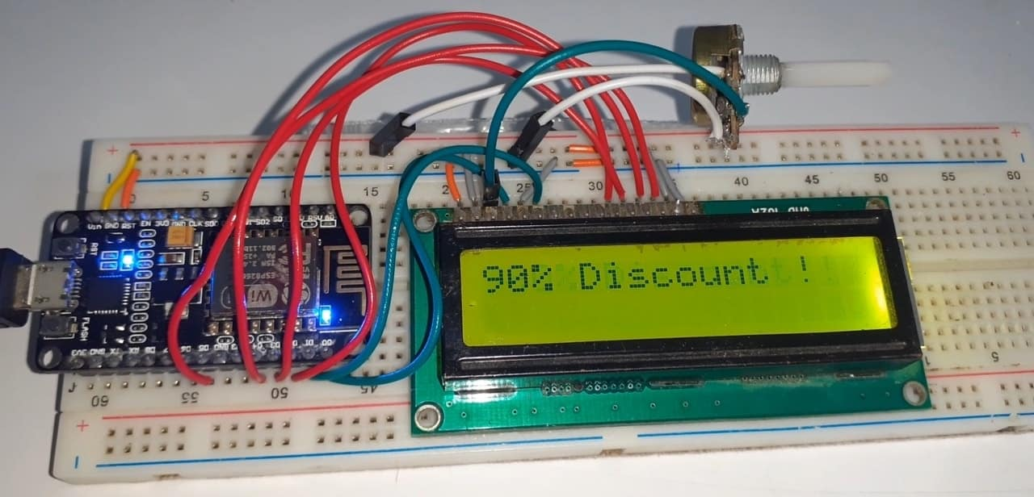
display

